Slide 1


Department of Computer Science University of Bristol
COMS10009 – Object-Oriented Programming 2019/20
OO Lecture 11
LAMBDAS & STREAMS
Tilo Burghardt | tilo@cs.bris.ac.uk
Sion Hannuna | sh1670@bris.ac.uk

Slide 2

Let’s start at the end

Slide 3
Stream Examples
Live code demo

Slide 4
Where does this new syntax come from?
String[] names = {"Sebastian", "Mutalib", "Tom", "Tilo“ … Arrays.stream(names) .filter(x -> x.startsWith("S")) .sorted() .forEach(System.out::println);
Stream<T> | filter(Predicate<? super T> predicate) Returns a stream consisting of the elements of this stream that match the given predicate.
Interface Predicate<T> has a single abstract method, test:
boolean | test(T t) Evaluates this predicate on the given argument.
How do we reconcile the arguments to filter with this?

Slide 5
Predicate four ways, One
public class Main implements Predicate<String> { //@Override public boolean test(String s) { return s.startsWith("S"); } private void predicateOne(){ String[] names = {"Sebastian", "Mutalib”…
Arrays.stream(names) .filter(this) .sorted() .forEach(System.out::println); } …

Slide 6
Predicate four ways, Two
private void predicateTwo(){ String[] names = {"Sebastian", "Mutalib", …
Predicate <String> predicate= new Predicate <String>(){ public boolean test(String s) { return s.startsWith("S"); } }; Arrays.stream(names) .filter(predicate) .sorted() .forEach(System.out::println); }

Slide 7
Predicate four ways, Three
private void predicateThree(){ String[] names = {"Sebastian", "Mutalib… Predicate <String> predicate=(s) -> s.startsWith("S"); Arrays.stream(names) .filter(predicate) .sorted() .forEach(System.out::println); }

Slide 8
Predicate four ways, Four – back to where we started
private void predicateFour(){ String[] names = {"Sebastian", "Mutalib", … Arrays.stream(names) .filter(x -> x.startsWith("S")) .sorted() .forEach(System.out::println); }

Slide 9

“…whereas some declarative programmers only pay lip service to equational reasoning, users of functional languages exploit them every time they run a compiler, whether they notice it or not....”
--- Philip Wadler

Slide 10

Recap: Strategy Pattern

Slide 11
Recap: Strategy Pattern
SYNOPSIS
UML
code
comments
The Strategy Pattern defines a set of encapsulated algorithms that can be swapped to carry out a specific behaviour. [GoF]
import java.util.Comparator;
public class RobotLegsComparator implements Comparator<Robot> {
public int compare(Robot robotA, Robot robotB) {
return (robotA.numLegs - robotB.numLegs);
} }
calling the ‘doAlgorithm’ method with a concrete Strategy object triggers execution – it uses ‘execute’, but does not rely on its specific implementation
ConcreteStrategyA
interface Comparator<X> {
int compare(X x1, X x2);
}
execute()
Context
<interface> Strategy
various implementations can encapsulate functionality within objects – usually functionality resides in some methods
doAlgorithm(Strategy)
execute()
ConcreteStrategyB
import java.util.*;
class CompareWorld {
public static void main (String[] args) {
List<Robot> robots = new ArrayList<Robot>() {
{ add(new CarrierRobot());
add(new Robot("C3PO"));
} };
robots.get(0).charge(10);
robots.sort(new RobotPowerComparator());
robots.sort(new RobotLegsComparator());
} }
every concrete Strategy needs to provide a method for execution
execute()
import java.util.Comparator;
class RobotPowerComparator implements Comparator<Robot> {
public int compare(Robot robotA, Robot robotB) {
return (Math.round(robotA.powerLevel - robotB.powerLevel));
} }

Slide 12

Recap: Anonymous Inner Classes

Slide 13
Recap: Anonymous Instantiation of Inner Classes
inner classes are defined within another class
anonymous (inner) classes are defined and instantiated in a single place using new, where the anonymous class definition itself is actually an expression
inner classes are often local helper classes, whilst anonymous classes are often use-once helper classes without an explicit handle to the code that defines it
import java.util.Comparator;
class RobotPowerComparator implements Comparator<Robot> {
public int compare(Robot a, Robot b) {
return (Math.round(a.powerLevel - b.powerLevel));
} }
import java.util.*;
class CompareWorld {
public static void main (String[] args) {
SortedSet<Robot> robots =
new TreeSet<>( new Comparator<Robot>() {
public int compare(Robot a, Robot b) {
return (Math.round(a.powerLevel - b.powerLevel));
} } );
Robot c3po = new Robot("C3PO");
c3po.charge(10);
robots.add(c3po);
robots.add(new CarrierRobot());
System.out.println(robots);
} }
instead of defining a new class in a new file, we can create and define a class ‘in-situ’ – this removes a lot of overhead, yet provides no handle for using the definition again for another object

Slide 14
That’s a lot of code!
If Java is the answer, it must have been a really verbose question.

Slide 15
A First Motivation for ‘Code as Data’
thus, sometimes we use message parameters to hand over objects to the receiver in order to provide the object’s method capabilities
however, we still have to write a whole class to supply just the functionality of a single method to the receiver
it would be handy to allow just the code (i.e. a method body with its parameters) as arguments in method calls
more generally, we would like to reference computational functionality (other OO languages use function pointers etc)
...
class CompareWorld {
public static void main (String[] args) {
SortedSet<Robot> robots =
new TreeSet<Robot>(new Comparator<Robot>() {
public int compare(Robot a, Robot b) {
return (Math.round(a.powerLevel - b.powerLevel));
}
});
...
} }
the anonymous inner class (in red) serves as a parameter to supply the TreeSet instance with the functionality for comparing robots

Slide 16

Lambdas

Slide 17
Lambdas and Single Abstract Method (SAM) Interfaces
for single-method interfaces, Java allows to replace an anonymous inner class with just ‘the essence’ of its only method: 1) the input parameters, 2) the -> arrow symbol, and 3) an expression or code block that produces the result
...
class CompareWorld {
public static void main (String[] args) {
SortedSet<Robot> robots =
new TreeSet<Robot>(new Comparator<Robot>() {
public int compare(Robot robotA, Robot robotB) {
return (Math.round(robotA.powerLevel - robotB.powerLevel));
}
});
...
} }
interface Comparator<X> {
int compare(X x1, X x2);
}
...the single abstract method (SAM) interface...
1) the type of the input variables has to match the interface signature (here: type inference from type parameter is used)
...
class CompareWorld {
public static void main (String[] args) {
SortedSet<Robot> robots =
new TreeSet<Robot>((robotA, robotB) ->
Math.round(robotA.powerLevel - robotB.powerLevel));
...
} }
type inference allows to connect our Lambda to the interface it implements (which is never mentioned!)
2) the arrow symbol indicates the use of a Lambda expression
3) the result of this expression is automatically mapped to be the return value of the compare method – the return type has to match up with the interface definition of the only method

Slide 18
Basic Concepts around Lambdas
conceptually, a lambda expression is an unnamed function, a piece of reusable code that can be treated as functionality data that is passed around (used as arguments etc)
it has a type signature (from the interface it is encapsulated within) and a body (the provided code block), but no name
yet, a Lambda can be referenced just as objects can be:
in contrast to some functional languages such as Haskell, in Java a Lambda may or may not be pure, i.e., may or may not have any side effects
here the lambda expression is held in a reference ‘comp’ of type ‘Comparator<...>’, in this sense it still is an object with memory address etc
...
class CompareWorld {
public static void main (String[] args) {
Comparator<Robot> comp = (robotA, robotB) ->
Math.round(robotA.powerLevel - robotB.powerLevel);
SortedSet<Robot> robots = new TreeSet<>(comp);
...
} }
the reference can be used in the same way as an object of the same type (a.k.a. the lambda object), in fact both are conceptually identical

Slide 19
Impure Lambdas and Side Effects
since a Lambda can contain a code block, all objects or state in scope and accessible may be mutated – as a result such Lambdas are not pure anymore and have side effects:
this line manipulates state outside the local scope of the function – the full effects are often difficult to forecast
(therefore: minimize side effects as much as possible for clearer, usually better programs)
...
class CompareWorld {
public static void main (String[] args) {
Comparator<Robot> comp = (robotA, robotB) -> {
robotA.charge(10);
return Math.round(robotA.powerLevel - robotB.powerLevel);
};
SortedSet<Robot> robots =
new TreeSet<>(comp);
...
} }
potentially even more problematic, in Java objects outside the set of input arguments may be manipulated; here a robot object is ‘charged’, which is not one of the input arguments
...
class CompareWorld {
public static void main (String[] args) {
final Robot robot = new Robot();
Comparator<Robot> comp = (robotA, robotB) -> {
robot.charge(10);
return Math.round(robotA.powerLevel - robotB.powerLevel);
};
SortedSet<Robot> robots =
new TreeSet<>(comp);
...
} }

Slide 20

Functional Interfaces

Slide 21
Using Lambdas with Functional Interfaces
as mentioned before, Lambdas can be seen as implementations of interfaces with one single method
thus, often programmers provide an interface of the suitable signature, and then instantiate an object that implements this interface via a Lambda expression
the encapsulating object is then typed by the interface and can reference the Lambda
this way, the Lambda can be passed around like an object
@FunctionalInterface
public interface MyStringTransform {
String transform(String string);
}
public class FunctionalWorld {
static public String doTransform( String string, MyStringTransform f) {
return f.transform(string);
}
public static void main(String args[]) {
MyStringTransform transform = input -> input + " transformed";
String result = doTransform("message", transform);
System.out.println(result);
} }

Slide 22
Artefacts of Functional Interfaces
as mentioned before, a functional interface is an interface which contains exactly one method
as we have seen with Comparator, such interfaces existed already before Lambdas were introduced in Java 8, e.g. Runnable, Readable, Callable, Iterable, Closeable, Flushable, Formattable, Comparable, or FileFilter
the Java designers decided that the compiler converts each lambda expression to a matching functional interface type – this is possible in every case
there are some artefacts created by this notion: for instance, there may now be various, incompatible interfaces of identical type
...
interface Executable {
public void execute();
}
...
class CompareWorld {
public static void main (String[] args) {
...
Runnable runMe = () -> {};
Executable executeMe = () -> {};
//runMe = executeMe; //DOES NOT WORK WITHOUT CAST!
...
} }

Slide 23
More on Functional Interfaces
all functional interfaces are recommended to have an informative @FunctionalInterface annotation in their code
default methods are not abstract; thus, a functional interface may still have multiple default methods
Java also provides a simple, generic functional interface that receives one value and returns another; the interface Function<T,R> represents it
many other functional interfaces are shipped with Java; we will cover some of them in the future
import java.util.function.Function;
class FunctionalWorld {
static public String doTransform( String string, Function<String,String> f) {
return f.apply(string);
}
public static void main(String args[]) {
Function<String,String> transform = input -> input + " transformed";
String result = doTransform("message", transform);
System.out.println(result);
} }

Slide 24
Example: Overloading with Functional Interfaces
import java.util.function.Consumer;
import java.util.function.Function;
public interface OverloadInterface {
String doTransform(Function<String, String> f);
void doTransform(Consumer<Integer> f);
}
import java.util.function.Consumer;
import java.util.function.Function;
public class OverloadWorld implements OverloadInterface {
@Override
public String doTransform(Function<String, String> f) {
return f.apply("Something ");
}
@Override
public void doTransform(Consumer<Integer> f) {}
public static void main(String args[]) {
OverloadWorld myInstance = new OverloadWorld();
String result = myInstance.doTransform(a -> a + " transformed");
System.out.println(result);
} }
tricky type inference that allows to match the Lambda to one of two overloaded abstract methods – try to avoid overloading in this case

Slide 25

Bulk Operations

Slide 26
Motivation for Bulk Operations
problem of replacing serial, single-threaded execution by parallel, multi-threaded one: we need an interface for this!
Iterators explicitly step-through a Collection serially
Idea: the user supplies an operation (via a Lambda) and can apply it to an entire Collection automatically → element-wise code (the Lambda) and application to elements (possibly parallelisation) are now separated
this notion of internal iteration (handing over your functionality to a method that applies it to all elements) replaces external iteration (getting each element and applying the functionality to it in an explicit loop)

Slide 27
forEach
instead of using an Iterator, one can use a method that is attached to every Collection for applying functionality:
the associated Consumer interface (you will remember it from your courseworks) is called by for each for all elements:
Consumer is a functional SAM interface, thus we supply forEach’s parameter as a Lambda instead of a Consumer object:
public void forEach(Consumer<? super T> consumer);
public interface Consumer<T> { public void accept(T t); }
class RobotWorld {
public static void main (String[] args) {
List<Robot> robots = new ArrayList<Robot>() {
{ add(new Robot("C3PO"));
add(new Robot("C4PO"));
add(new Robot("C5PO"));
}
};
robots.forEach(robot -> robot.charge(10)); ...
} }
this is an alternative to an external for-loop that steps through each element and calls the ‘charge’ method on it, instead we supply a Lambda as functionality to be executed ‘forEach’ element

Slide 28
Streams
in the case of forEach(), the Collection is responsibility for supplying the means to access all elements and how to apply the specified functionality to them, the user is responsible for supplying functionality to be applied to each of the sequence elements
Java 8 introduces a new interface Stream<E> and a method stream() for Collections to turn the latter into the former – this offers a subset-view to a Collection
Java supplies many more bulk operations for streams including forEach, filter, map, reduce ... to name a few
some of these methods produce a Stream as a return type, thus one can easily produce chains of processing (this style is also known as fluent programming)

Slide 29
Concept of Fluent Programming
resulting method cascading (i.e. chaining) produces linearly readable code, which is often easy to understand
This fluent programming style is a departure from classical object-orientation! – (avoid in your coursework if possible)
import java.util.*;
class RobotWorld {
public static void main (String[] args) {
List<Robot> robots = new ArrayList<Robot>() {
{ add(new Robot("C3PO"));
add(new Robot("C4PO"));
add(new Robot("C5PO"));
}
};
robots
.stream()
.filter(r -> !r.name.equals("C3PO"))
.map(r -> r.name)
.forEach(s -> System.out.println(s));
} }
‘map’ takes a Stream and returns a Stream replacing every element with the result of the Lambda expression; here: the Stream of two Robot objects is turned into a Stream of two String objects containing the String “C4PO” and the String “C5PO”
‘filter’ takes a Stream and returns a Stream retaining only those elements for which the Lambda expression is true; here: two elements C4PO and C5PO are in the result
get a Stream view of the List of Robot objects
FLUENT STYLE
finally, we iterate through all members of the Stream using internal iteration, printing out each String

Slide 30
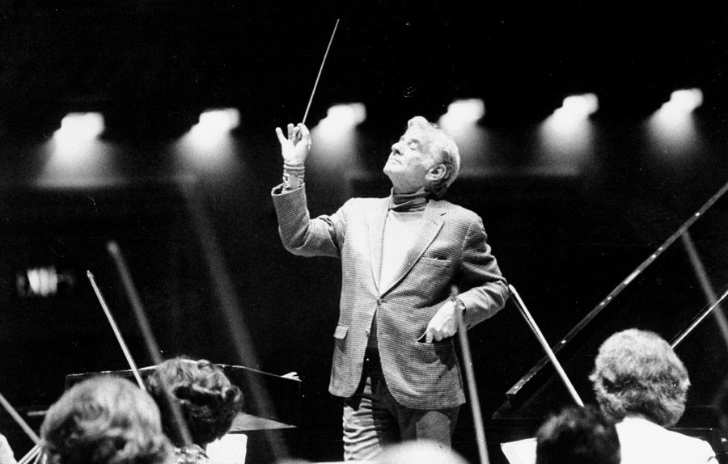





To Do
recap content and check out the unit website
write, compile, run and understand ALL the tiny programs from the lectures so far
→Remember that we currently recommend 9 hours of time to go into this unit per week overall – work in your team of two as often as possible. Ask yourself: Would you be ready for a theory exam on OO tomorrow? Am I far enough through the project? Is my team working efficiently?

